Slide 1
Limited Liability Company
"Chrystyna"
Best packaging for your products!

Slide 2
About Us
LLC "Chrystyna" was founded in 1997. The main activity of the company is manufacturing corrugated containers of all shapes and sizes that can be used for packaging, storage and transport of various types of products, from food to household.
The advantage of our company over others is that we can: provide free samples of finished products to its customers; existing in the company fleet enables the delivery of the ordered products to the customer at his convenience.
Our company can provide services from applying color printing on the package (logos, images, etc).
Persistent our customers enjoy the following benefits:
flexible pricing and discounts; availability of finished products in stock allowing any time to provide customers corrugated packaging;
transport logistics quickly make corrugated container delivery to the customer;
qualified consulting managers, individual work with clients.
Manufactured corrugated specialists Ltd. "Christine" in compliance with all requirements of current legislation on protection of Environment and Labour. This ensures the quality of our products!

Slide 3
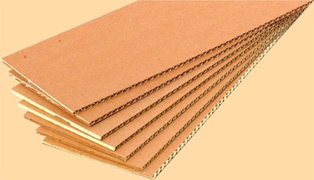
Corrugated its benefits
As you know, any product packaging needs.
Most manufacturers prefer corrugated cardboard. This material is considered universal because combines many essential qualities.
Package made ​​of corrugated cardboard are relatively inexpensive, it's light and compact, easily utilized without causing harm to the environment.
In this case, it can protect the goods from various unfavorable factors and troubles that beset him in warehousing, transportation, damage resulting from a fall or mechanical stress, moisture, sunlight, dust. That's why corrugated packaging is not as commutable in many different areas - food processing, construction materials, pharmaceutical and other activities.
LLC "Chrystyna" offers food producers as well as non-food products wide range of corrugated packaging - corrugated boxes, corrugated boxes, hofroelementy (gaskets, gratings) of different types of cardboard and color.

Slide 4
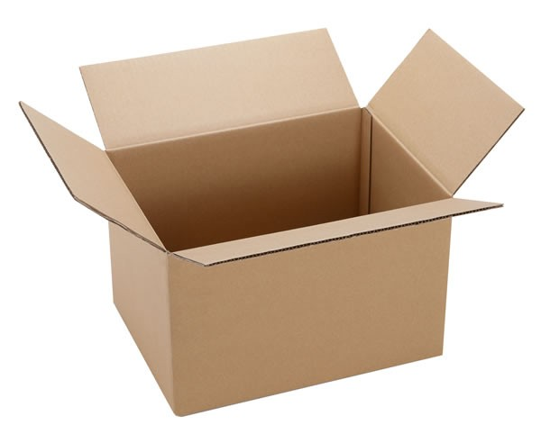
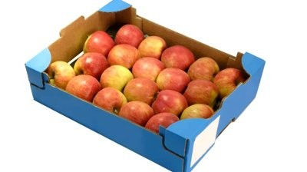
Our Products :
Assembly four valve boxes
Is the most common type of packaging made ​​from three-layer corrugated cardboard any size or double-wall corrugated board, depending on the functional load on the box.
Boxes for fruits and vegetables
Our production is standard dies for the production of corrugated boxes for strawberries, raspberries, cherries and cherries, apples and pears, grapes, cucumbers, tomatoes and other agricultural gifts of nature.
Modern equipment allows the company to make any drawer for fruits and vegetables with the ability to print the application. Manufacturing of boxes of different designs.

Slide 5
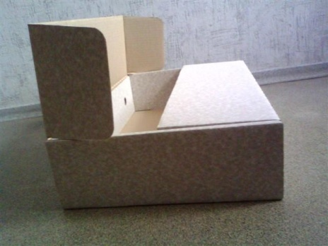
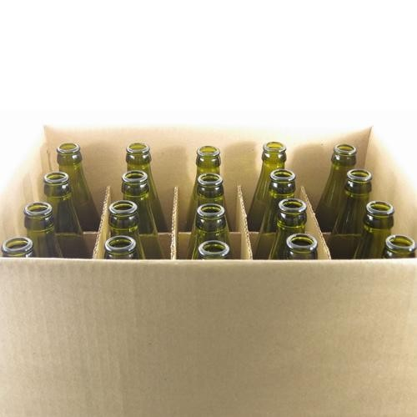
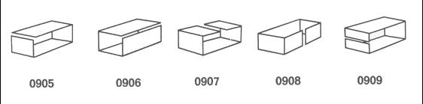
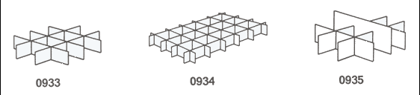
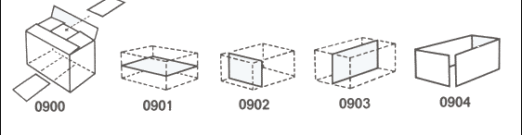
Boxes for beverages
Typically uses a standard four-valve box, which comes with an additional:
grating
bulkheads and linings
shell
Boxes for meat and frozen products
Made with a durable brands of recycled cellulose or cardboard, as this product is in a wet environment.

Slide 6
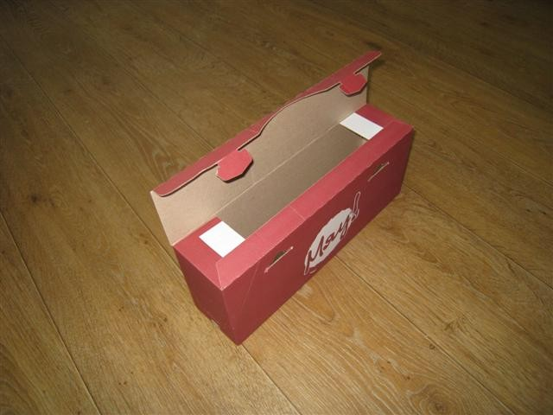
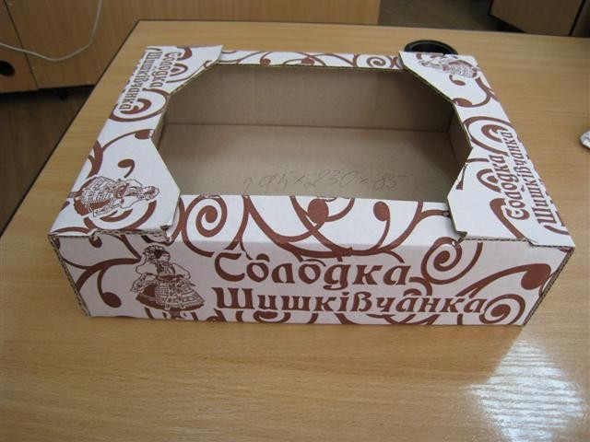
Made self-build complex cutting
All self-build boxes are manufactured using punching molds. Packing of complex structures made ​​from large database libraries constructs, including catalog and FEFCO ASSCO.
Trays of cookies under
Our company has great achievements in the production of trays during cookies (pastry trays) of various designs, sizes

Slide 7
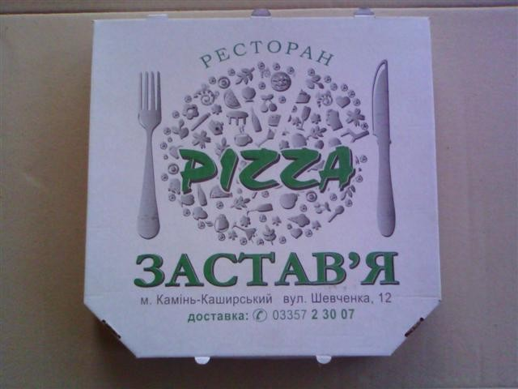
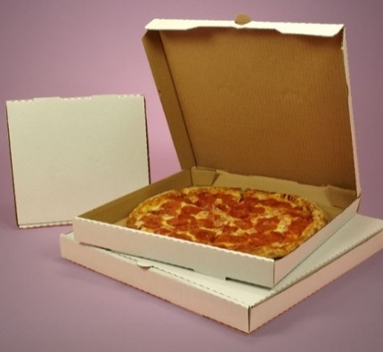
Pizza boxes under
Cardboard pizza made ​​using cardboard complex cutting and applying the tri-color print according to customer's requirements. Pizza boxes do not soak fat and steam keeps its shape and color.
All used materials meet appropriate food certificates.

Slide 8
Contact:
Str. Zamosc, 4, Berezhany, 47501, Ukraine
tel. / fax: (03548) 21725, 25739;
mob.: 0673545849, 0673545249, 0673506523;
e-mail: chrystynaLTD@ukr.net; office@chrystyna.com.ua;
URL: http://www.chrystyna.com.ua
Looking forward to cooperate with you!

