Slide 1

FOOD PRODUCING FROM 1968
OWN BRAND AND PRIVATE LABLE PRODUCTS
WE KEEP THE PRINCIPLES OF HIGH QUALITY AND STANDARDS OF WORK
READY FOR EFFECTIVE COOPERATION WITH PARTNERS

Slide 2
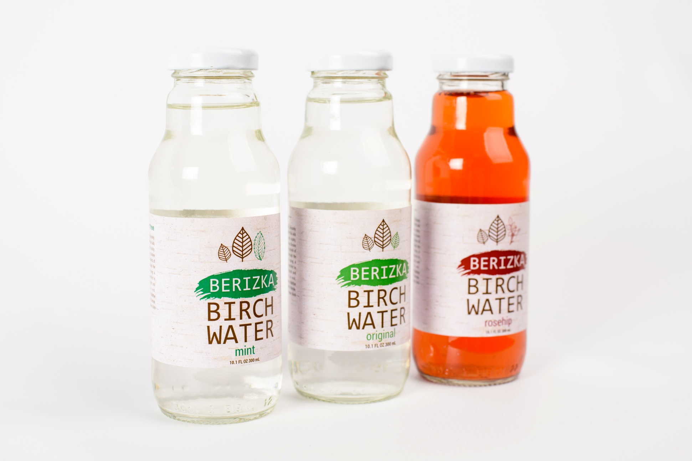

Slide 3


Slide 4
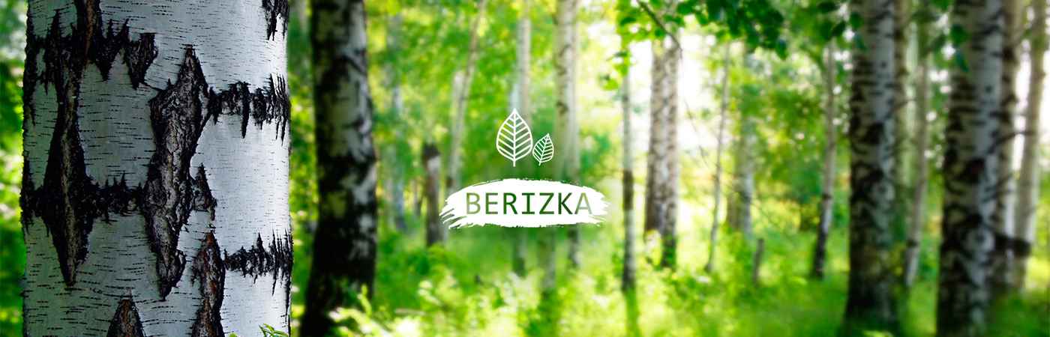




SIMPLE
It contains only
natural ingredients.
USEFUL
It is rich with organic acids,
minerals, iron, potassium.
HEALING
Sap strengthens the immune system,
makes lower level of cholesterol,
stimulates restoring of the body's
metabolism and cleanse it.
REFRESHING
It has sweet-tart taste
by nature.

Slide 5
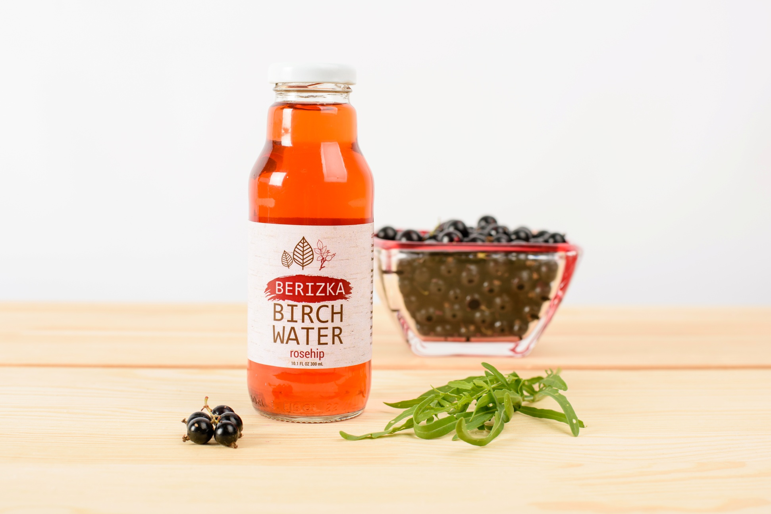

Slide 6




WINTER
It's a period of
Peace.
Tree rests.
MARCH - APRIL
Natural birch sap awakes the
tree from a winter sleep
and
flows up on the trunk, so
it is
Naturally filtered
through the
wood.
SPRING - SUMMER
It's a period of flowering
and growth.
Birch gains strength
Absorbing rich minerals
from the soil.
AUTUMN
Vegetative
period.

Slide 7
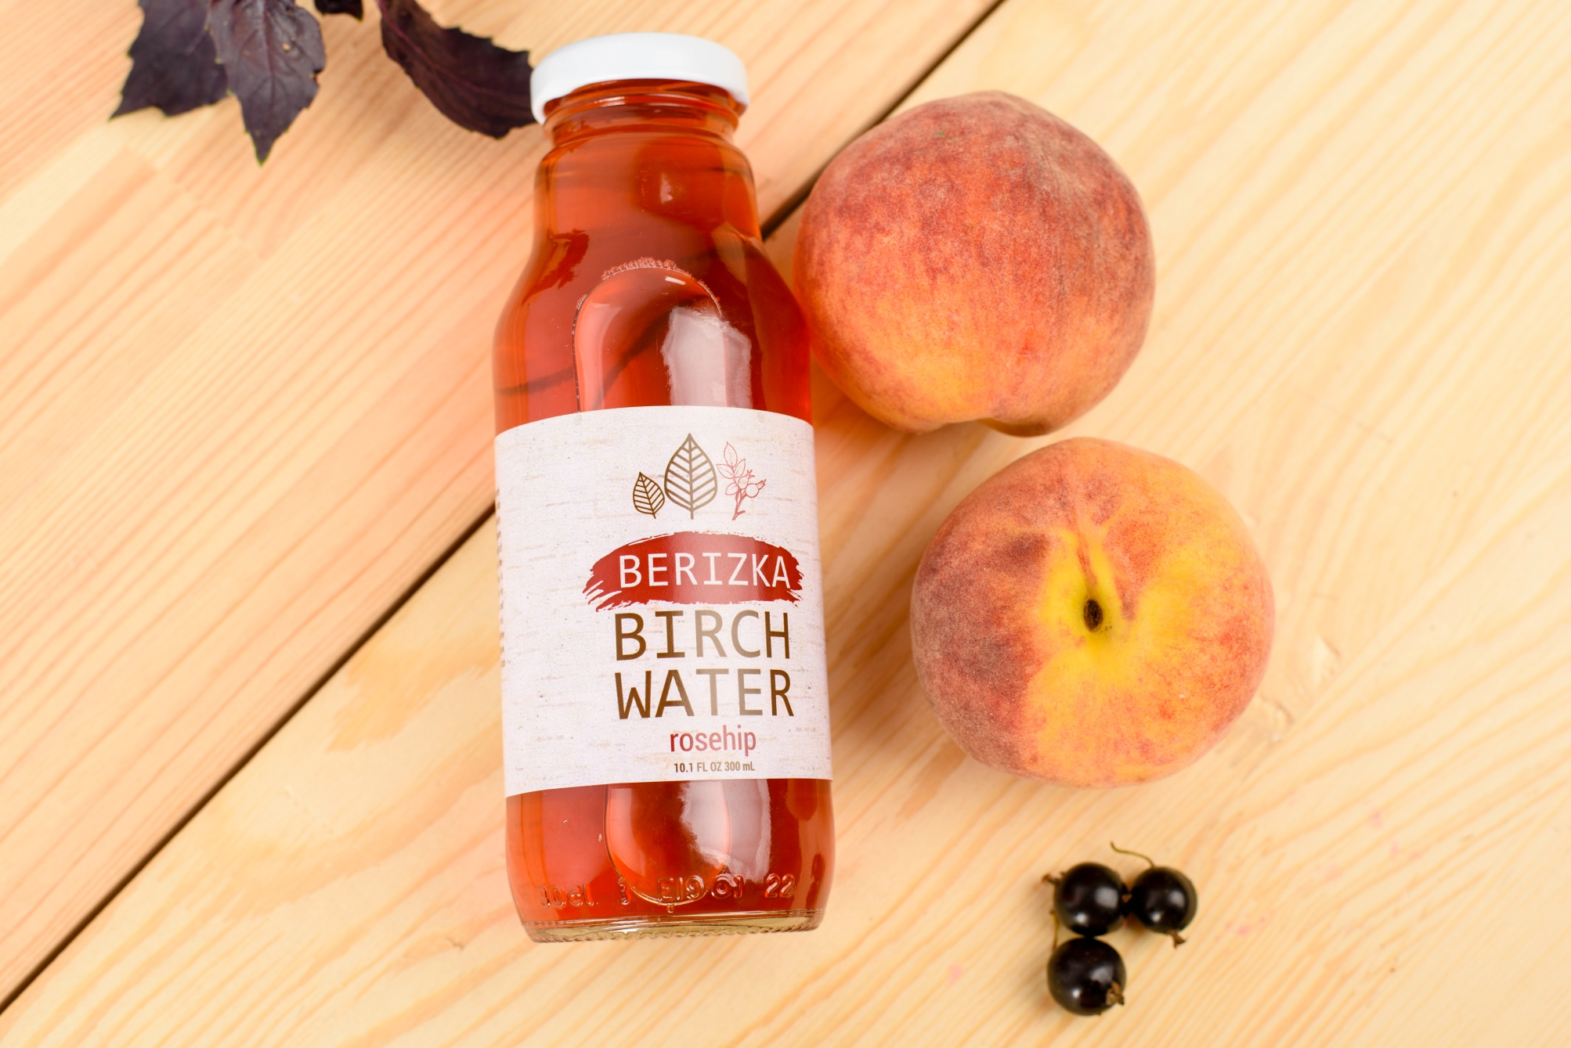

Slide 8
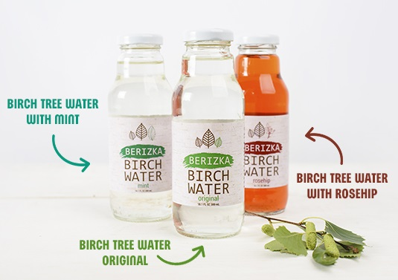
100% NATURAL
SUGAR FREE
LOW-CALORIE
WITH MINT AND ROSEHIP INFUSION
GLASS BOTTLE

Slide 9
Name of product | ml | packaging | the number of packages on a pallet | amount bottles on a pallet | Price EUR / bottle FCA Demydivka | Shelf life
Birch Tree Water original | 300 | 12 | 200 | 2400 | 0.39 | 12 mon
Birch Tree Water mint | 300 | 12 | 200 | 2400 | 0.42 | 12 mon
Birch Tree Water rosehip | 300 | 12 | 200 | 2400 | 0.42 | 12 mon
Bohdan Pivnyuk
Commercial director, Demidovskiy cannery
+380951646187, +380967656617, bpivnyuk@gmail.com
www.demydivproduct.com, www.berizkawater.com

